Slide 1


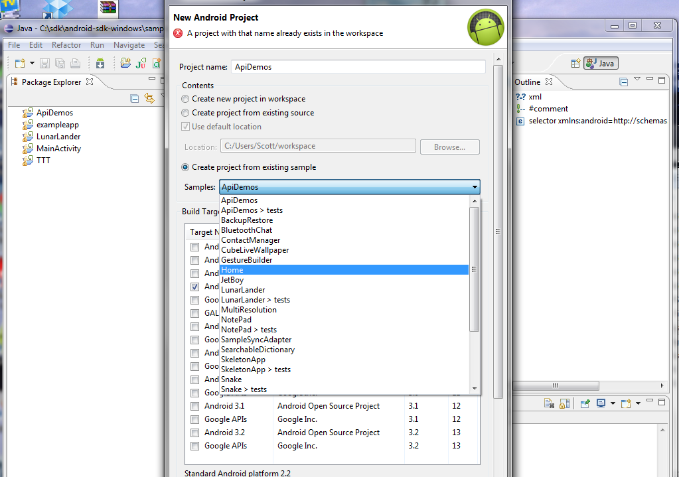
Problem Solving Day
Dimitar Ivanov
Android Mobile Applications
Telerik Software Academy
http://academy.telerik.com

Slide 2
Tasks
Reverse a String – Enter a string and the program will reverse it and print it out.
Count Words in a String – Counts the number of individual words in a string. For added complexity read these strings in from a text file and generate a summary.
Random Gift Suggestions – Enter various gifts for certain people when you think of them. When its time to give them a gift (xmas, birthday, anniversary) it will randomly pick one and perhaps places you can get it.

Slide 3
Tasks
Fortune Teller (Horoscope) – A program that checks your horoscope on various astrology sites and puts them together for you each day.
Product Inventory Project – Create an application which manages an inventory of products. Create a product class which has a price, id, and quantity on hand. Then create an inventory class which keeps track of various products and can sum up the inventory value.

Slide 4
Tasks
Movie Store – Manage video rentals and controls when videos are checked out, due to return, overdue fees and for added complexity create a summary of those accounts which are overdue for contact.

Slide 5
Problem Solving Day
http://academy.telerik.com

